Slide 1

Artificial language learning workshop: Lecture 1
James Brand
j.brand@lancaster.ac.uk

Slide 2
Overview
Artificial Language Learning
Outline
What you will learn in lectures 1 & 2:
What Artificial Language Learning (ALL) is
Why it is used in linguists research
How it is used in linguistics research
The validity of the paradigm

Slide 3
Overview
Artificial Language Learning
Outline
What you will learn in lectures 1 & 2:
Research that uses ALL to investigate grammar learning
Research that uses ALL to investigate word learning
Research that uses ALL to investigate reading
Research that uses ALL to investigate language evolution

Slide 4
Overview
Artificial Language Learning
Outline
What you will learn in lectures 3 & 4:
What it is like to take part in an ALL experiment
How to design ALL stimuli
How to program an ALL experiment in PsychoPy
How to interpret the data
Ways to design your own ALL experiment

Slide 5
Overview
Artificial Language Learning
What is artificial language learning?
Will I be learning about Valyrian, Dothraki, Klingon, Droidspeak etc.?

Slide 6
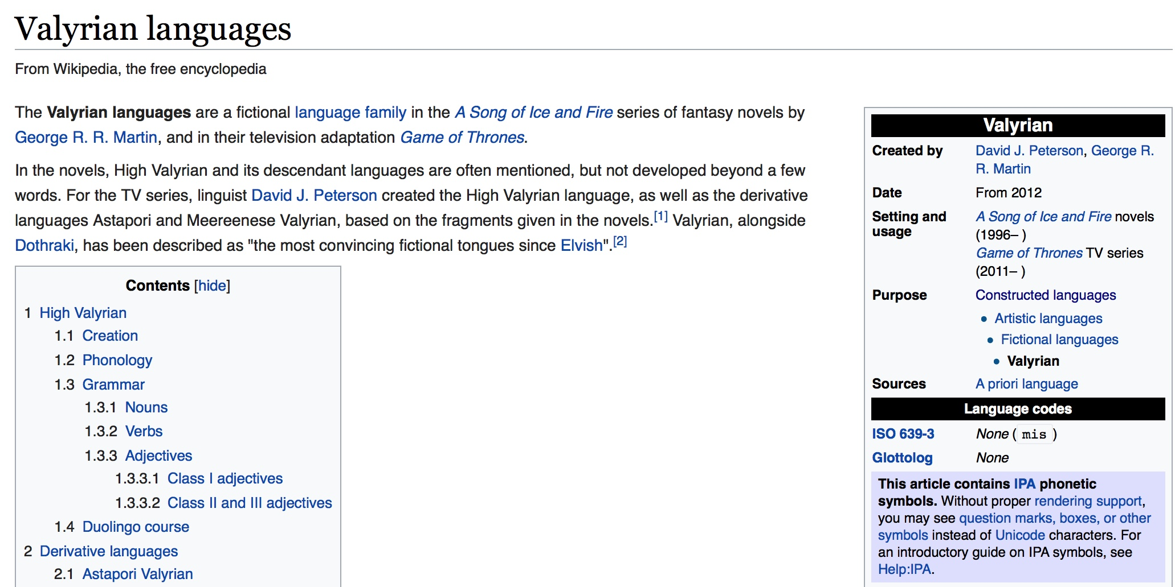
Overview
Artificial Language Learning
What is artificial language learning?

Slide 7
Overview
Artificial Language Learning
What is artificial language learning?

Slide 8
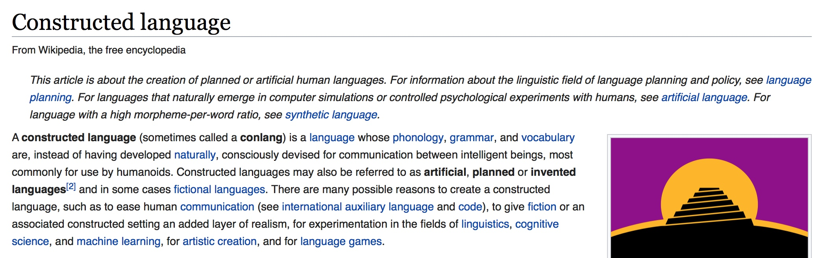
Overview
Artificial Language Learning
What is artificial language learning?

Slide 9
Overview
Artificial Language Learning
What is artificial language learning?
Will I be learning about Valyrian, Dothraki, Klingon, Droidspeak etc.?
NO

Slide 10
Overview
Artificial Language Learning
What is artificial language learning?
Will I be learning how to test predictions about the way language is learnt using carefully designed experiments?
YES

Slide 11
Overview
Artificial Language Learning
Why use artificial language learning?

Slide 12
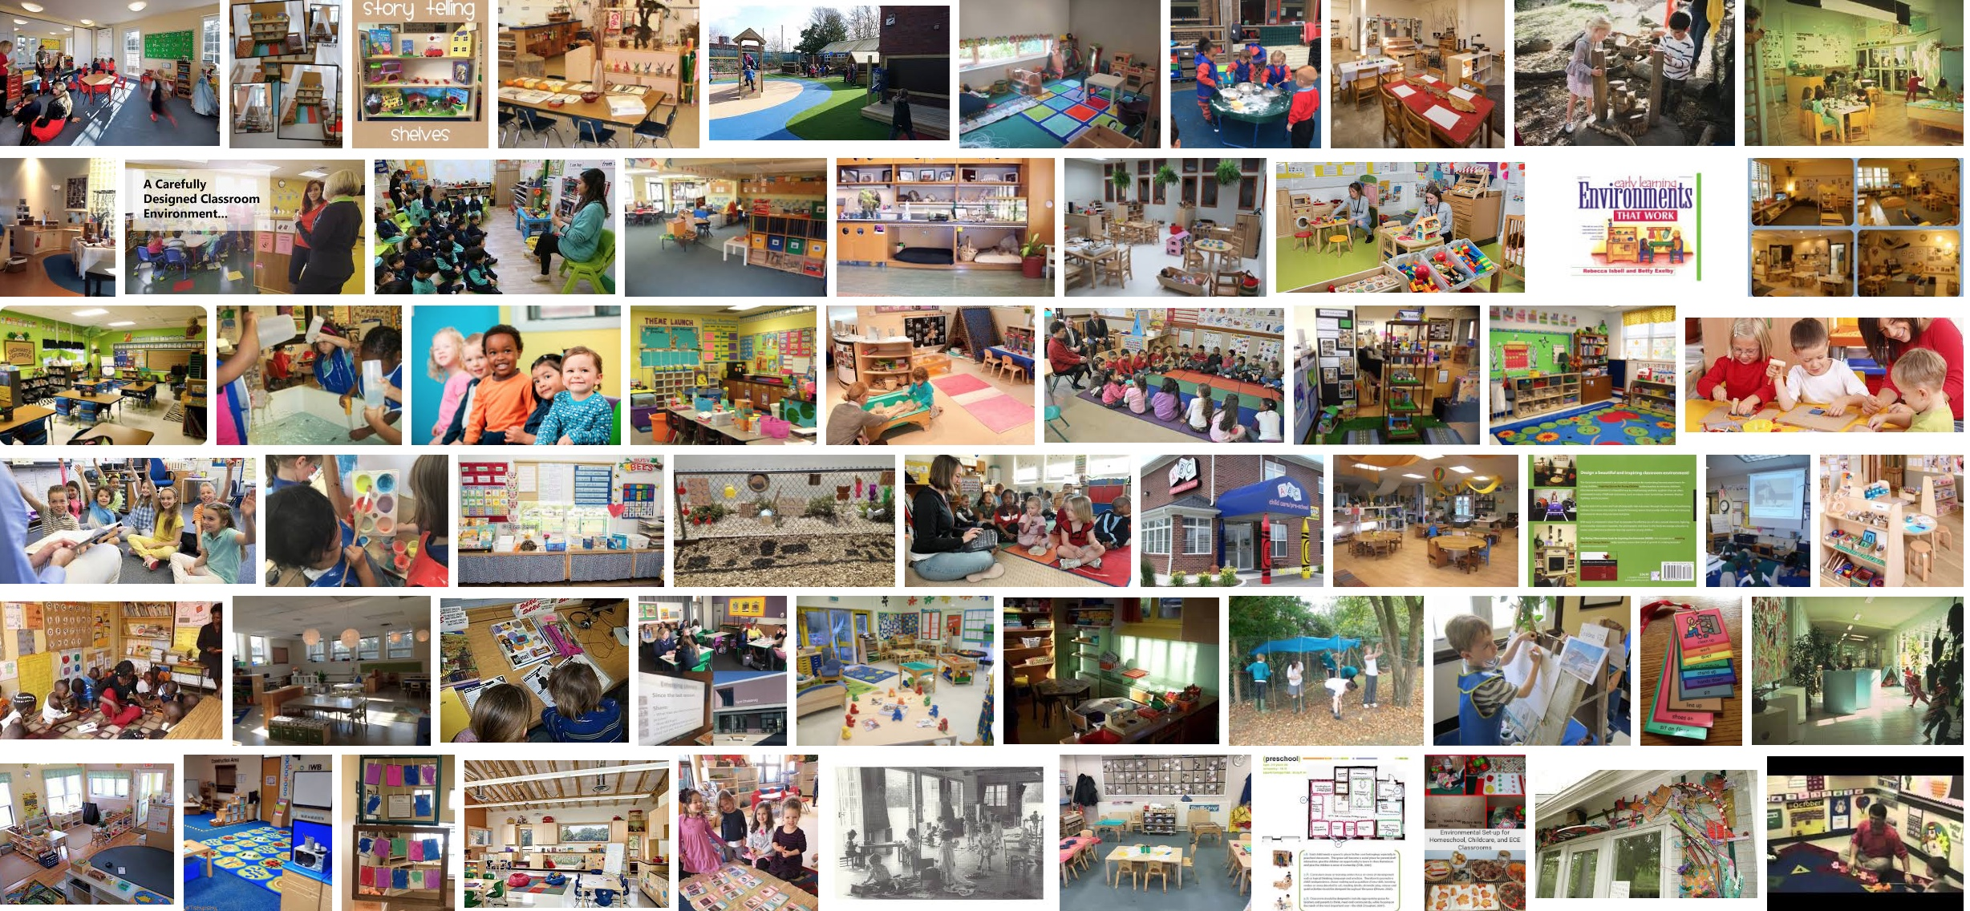
Overview
Artificial Language Learning
Why use artificial language learning?

Slide 13
Overview
Artificial Language Learning
Why use artificial language learning?

Slide 14
Overview
Artificial Language Learning
Why use artificial language learning?
ALL is best used in conjunction with other empirical methods
Corpus analyses
Computational modelling
Naturalistic recordings
Neuropsychological measures
Individual differences

Slide 15
Overview
Artificial Language Learning
What is artificial language learning?
The various forms of ALL…

Slide 16
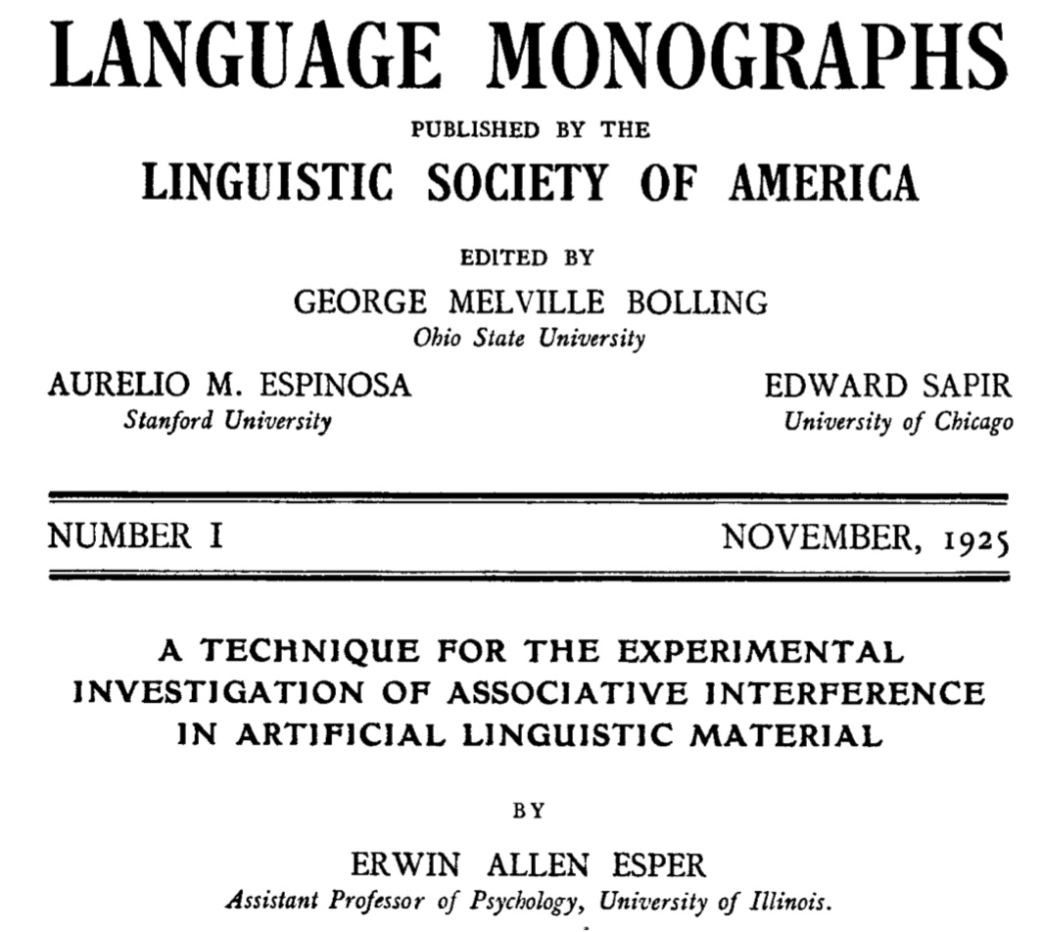
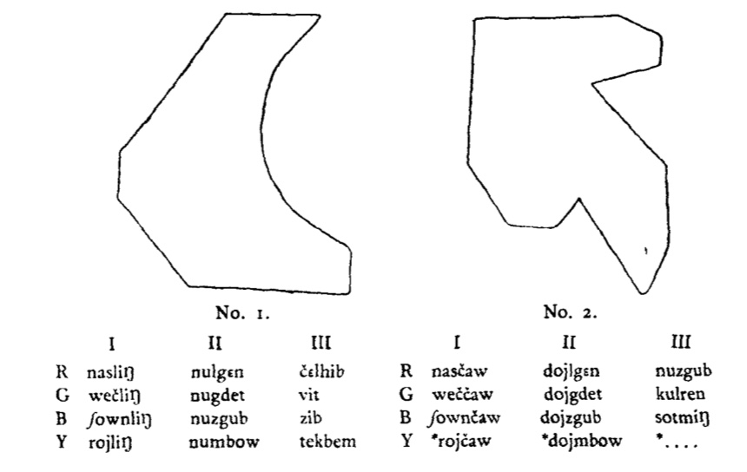
Overview
Artificial Language Learning
What is artificial language learning?
Esper (1925)

Slide 17
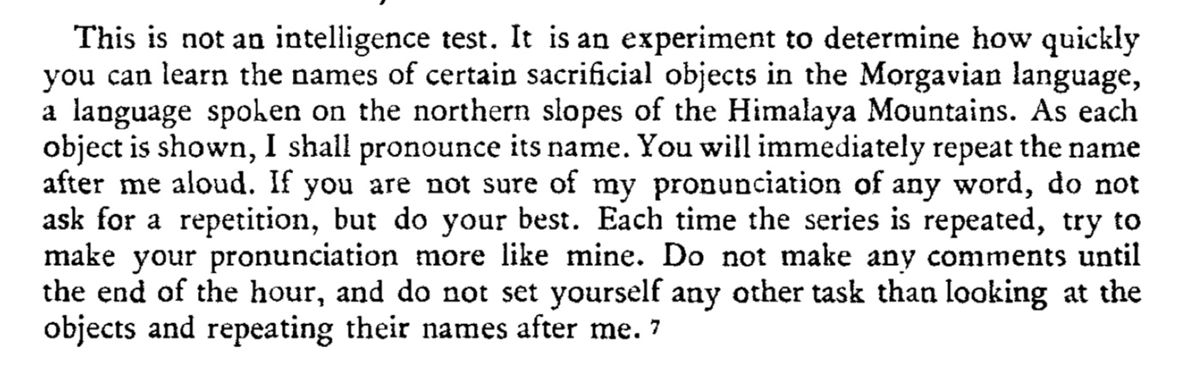
Overview
Artificial Language Learning
What is artificial language learning?
Esper (1925)

Slide 18
Overview
Artificial Language Learning
What is artificial language learning?
Köhler (1929)

Slide 19
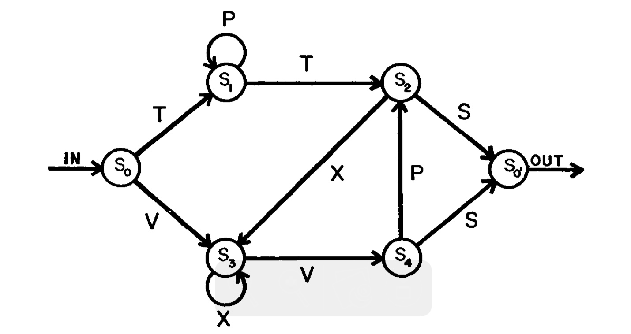
Overview
Artificial Language Learning
What is artificial language learning?
Reber (1967)

Slide 20
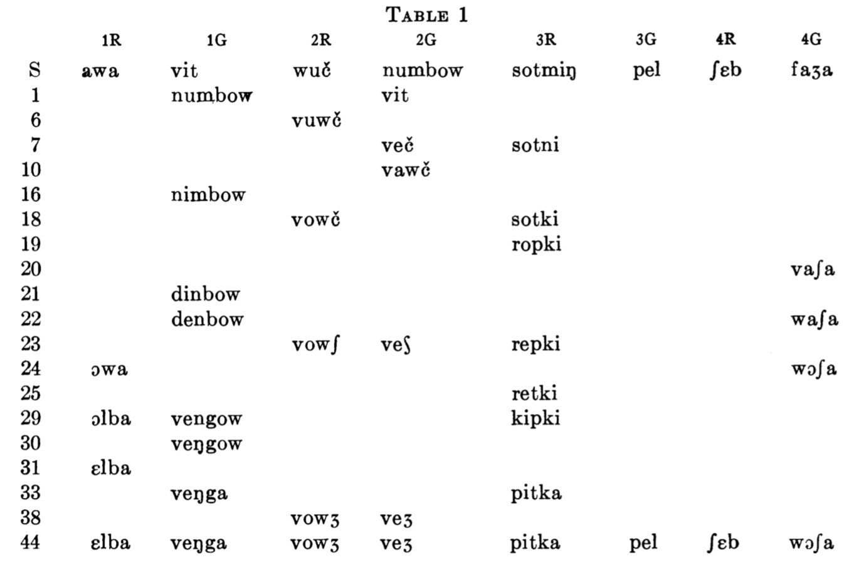
Overview
Artificial Language Learning
What is artificial language learning?
Esper (1966)

Slide 21
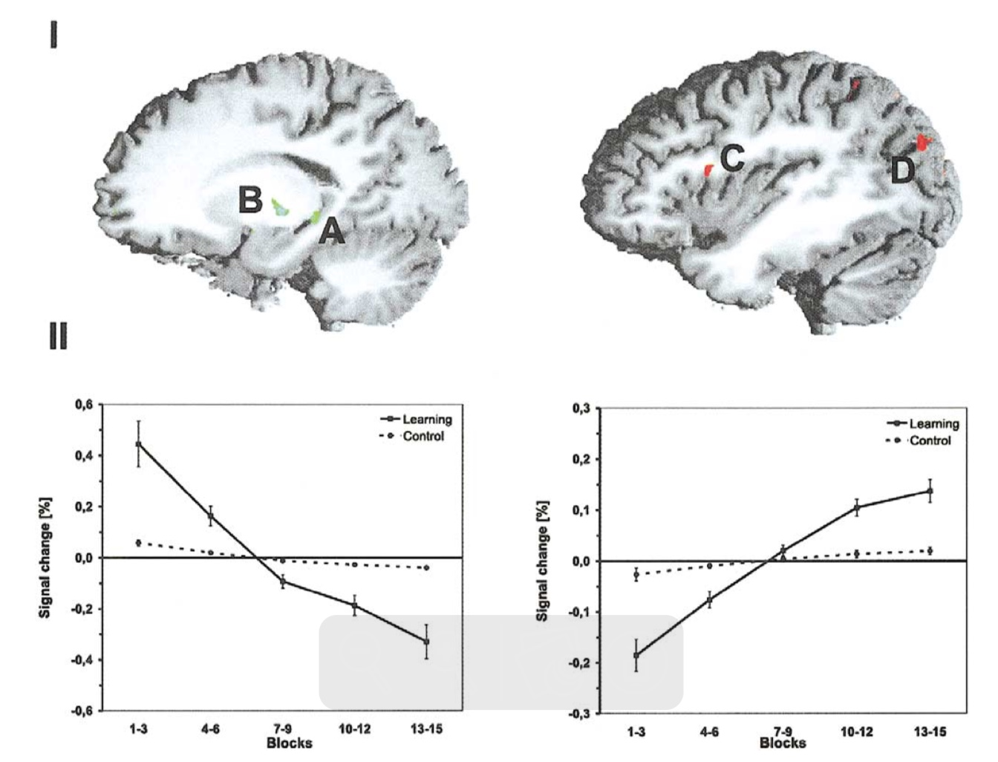
Overview
Artificial Language Learning
How valid are artificial language learning experiments?
Opitz & Friederici (2003)

Slide 22
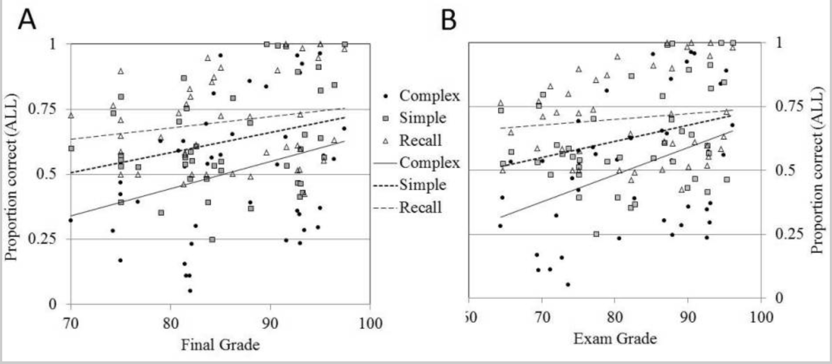
Overview
Artificial Language Learning
How valid are artificial language learning experiments?
Ettlinger et al. (2016)

Slide 23
Overview
Artificial Language Learning
Future directions of artificial language learning
https://mllewis.github.io/projects/RC/experiment38/refcomplex38.html

Slide 24
Overview
Artificial Language Learning
Future directions of artificial language learning
https://colorgame.net/en/

Slide 25
Overview
Artificial Language Learning
Important for lectures 3 & 4 (practical)
PsychoPy – to program and run an ALL experiment
http://psychopy.org/installation.html
Repository – to access lecture slides, experiment files, stimuli
https://github.com/jamesbrandscience/SSoL_2018

